Slide 1
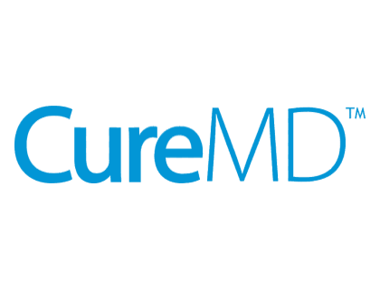

Advanced Object-Oriented Programming (C#)
SOLID Principles

Slide 2
📍Road Map
Story Framework Recap
What is Object-Oriented Programming? (OOP) — Quick Refresher
Why Does Good Design Matter? – City Analogy
What Are SOLID Principles?
Single Responsibility Principle (SRP)
Open/Closed Principle (OCP)
Liskov’s Substitution Principle (LSP)
Interface Segregation Principle (ISP)
Dependency Inversion Principle (DIP)
Understanding LSP, ISP, and DIP Through Design Clarity
Summary

Slide 3

Story Framework Recap
You’re the city’s foundational architects. Before building skyscrapers, roads, or power grids, you need to lay strong, well-planned foundations. To do this in software, we use SOLID principles — essential guidelines to keep code clean, flexible, and scalable.

Slide 4
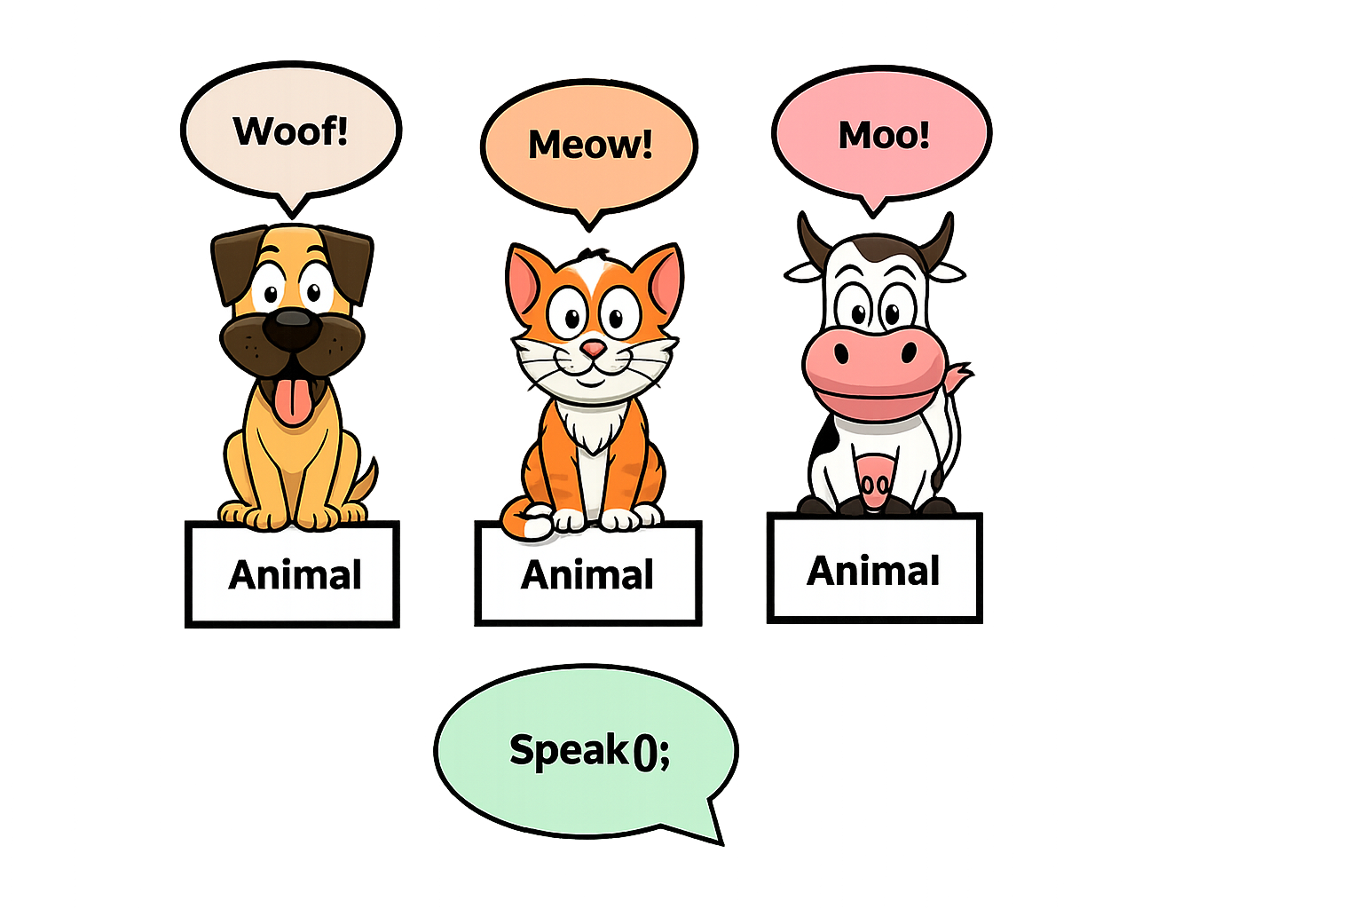
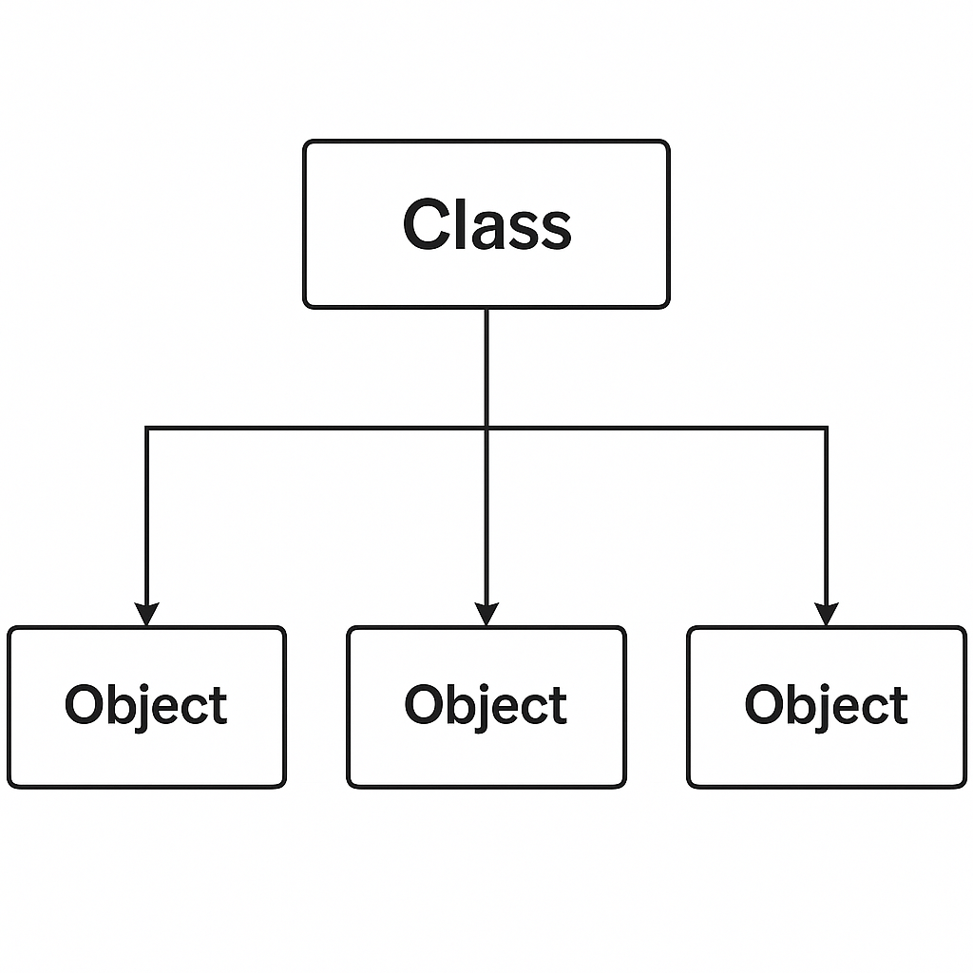
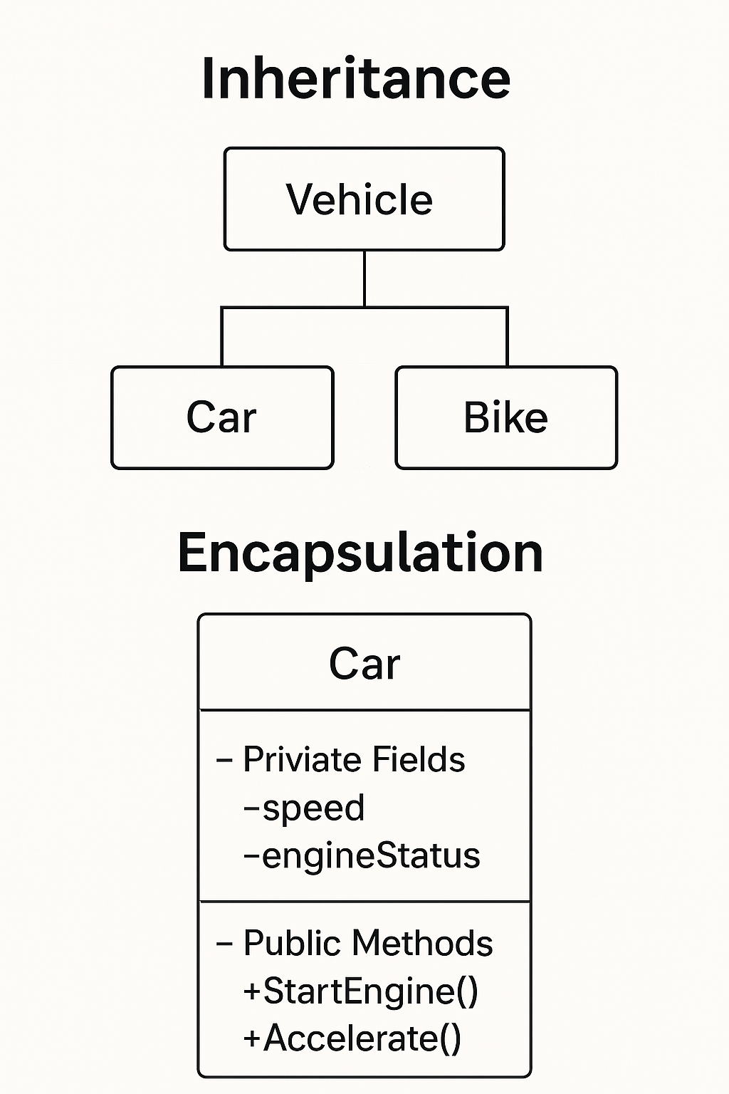
What is Object-Oriented Programming? (OOP) — Quick Refresher
OOP is a programming style focused on objects — representing real-world entities with data and behavior.
Core Concepts:
Classes & Objects: Templates and instances (e.g., a Car class, a specific car object)
Encapsulation: Bundling data and methods inside classes
Inheritance: Creating new classes from existing ones
Polymorphism: Ability of different classes to be treated through a common interface

Slide 5
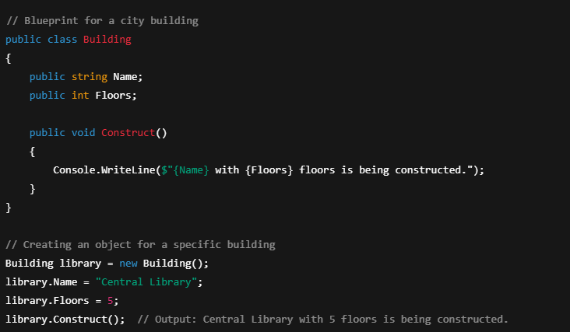
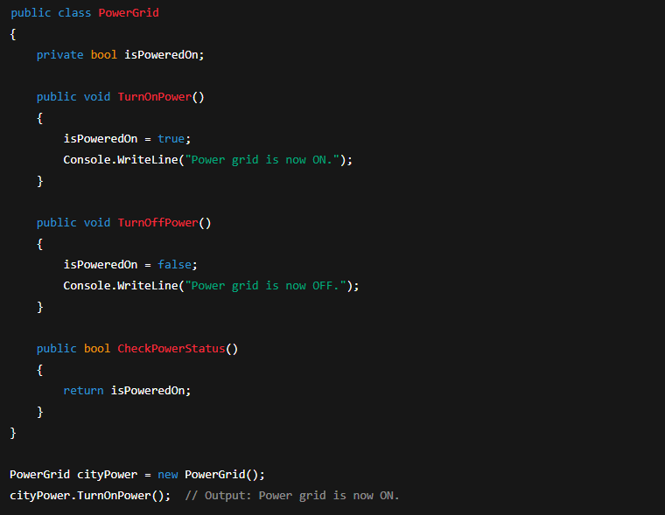
Continued….Examples
Classes & Objects
Encapsulation

Slide 6
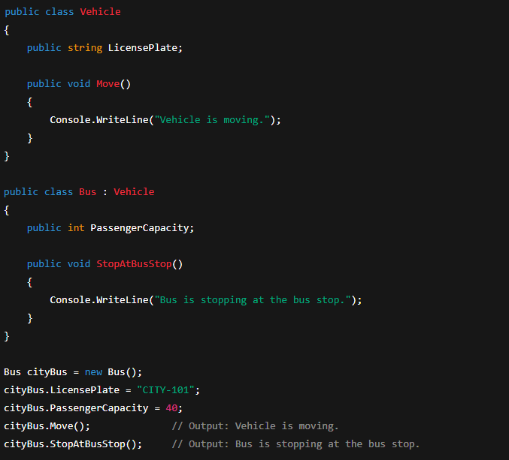
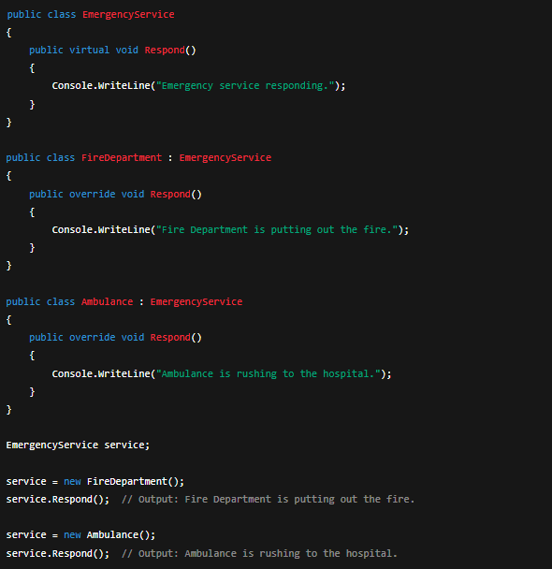
Continued….Examples
Inheritance
Polymorphism

Slide 7
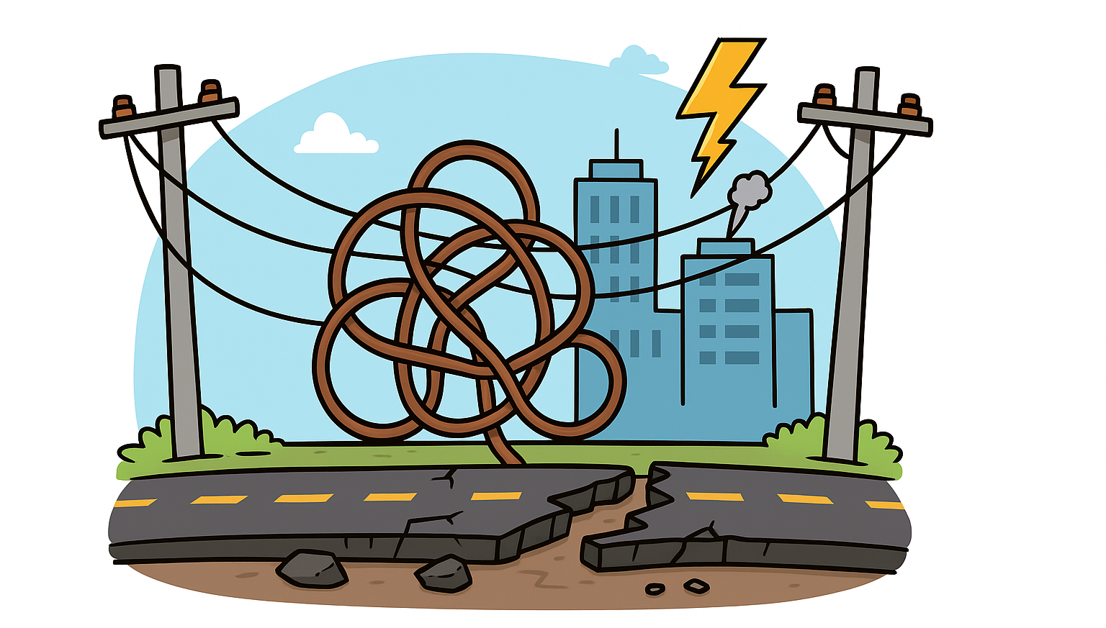
Why Does Good Design Matter? – City Analogy
Messy code can cause:
Rigidity: Hard to change one thing without breaking others
Fragility: Small changes cause bugs in unrelated parts
Duplication: Copy-pasted code everywhere
Difficulty Extending: Adding features takes too long and introduces errors
City Analogy:
Imagine a city with tangled power lines, roads breaking easily, and services crashing.
This is what messy, tightly coupled code feels like.
To prevent this, architects rely on principles — just like programmers rely on SOLID.

Slide 8
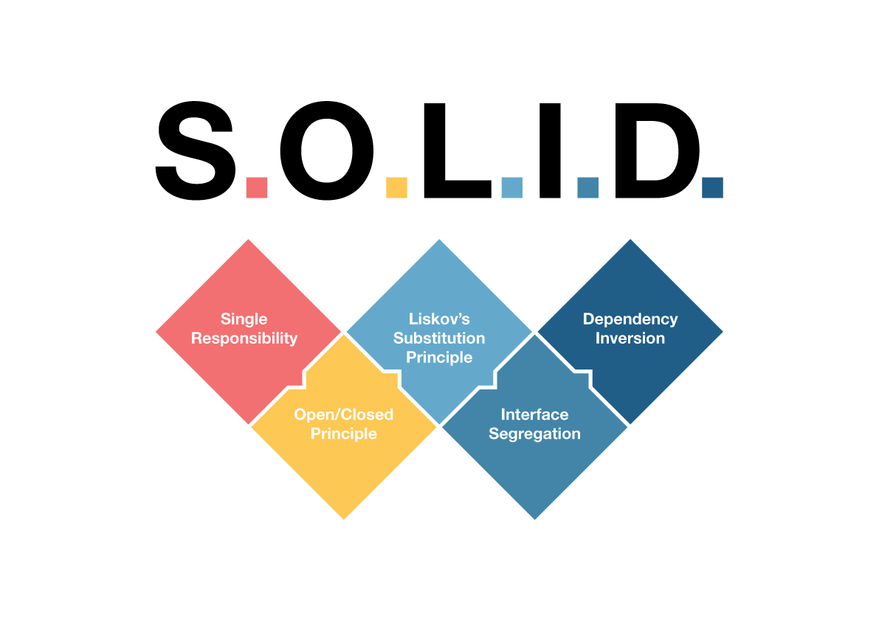
What Are SOLID Principles?
SOLID is an acronym for five design principles that make code easier to maintain and extend:
Single Responsibility
Open/Closed
Liskov’s Substitution
Interface Segregation
Dependency Inversion
They are like the blueprints for a strong city foundation.

Slide 9
Single Responsibility Principle (SRP)
SRP states:
“A class should have one, and only one, reason to change.”
This means each class should have a single responsibility or job, and that responsibility should be encapsulated fully within the class.
When a class handles multiple responsibilities, it becomes fragile and hard to maintain because changes related to one responsibility can break others.
Class violating SRP public class CityService
{
public void FixRoads()
{
Console.WriteLine("Fixing roads...");
}
public void RespondToEmergency()
{
Console.WriteLine("Responding to emergency...");
}
public void ProcessCitizenRequest()
{
Console.WriteLine("Processing citizen request...");
}
}
Why SRP Matters?
Improves maintainability: Changes to one responsibility don’t affect unrelated parts of the code.
Simplifies testing: Smaller classes with one function are easier to test thoroughly.
Enables better reusability: A class that does one thing well can be reused without unintended side effects.
Supports parallel development: Multiple teams can work on different classes independently without conflicts.

Slide 10
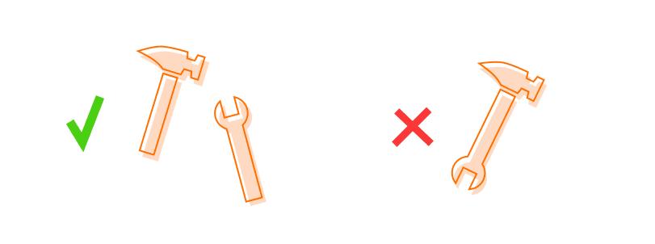
SRP Continued…
public class RoadMaintenanceService
{
public void FixRoads()
{
Console.WriteLine("Fixing roads...");
}
}
public class EmergencyResponseService
{
public void RespondToEmergency()
{
Console.WriteLine("Responding to emergency...");
}
}
public class CitizenRequestService
{
public void ProcessCitizenRequest()
{
Console.WriteLine("Processing citizen request...");
}
}
public class CityManager
{
private readonly RoadMaintenanceService _roadService;
private readonly EmergencyResponseService _emergencyService;
private readonly CitizenRequestService _citizenService;
public CityManager(RoadMaintenanceService roadService,
EmergencyResponseService emergencyService,
CitizenRequestService citizenService)
{
_roadService = roadService;
_emergencyService = emergencyService;
_citizenService = citizenService;
}
public void HandleCityOperations()
{
_roadService.FixRoads();
_emergencyService.RespondToEmergency();
_citizenService.ProcessCitizenRequest();
}
}

Slide 11
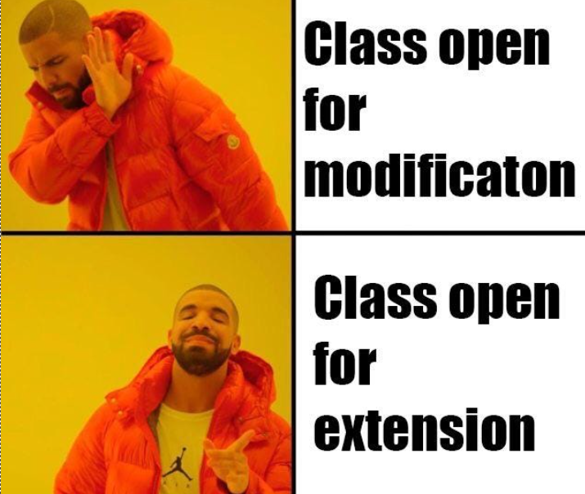
Open/Closed Principle (OCP)
OCP states:
“Software entities (classes, modules, functions, etc.) should be open for extension, but closed for modification.”
Meaning: Add new functionality by adding code, not changing existing tested code.
Class violating OCP public class Building
{
public string Type { get; set; }
public void Construct()
{
if (Type == "House")
{
Console.WriteLine("Constructing a House.");
}
else if (Type == "Hospital")
{
Console.WriteLine("Constructing a Hospital.");
}
else
{
Console.WriteLine("Constructing a generic building.");
}
}
}
Why OCP Matters?
Protects existing, tested code from bugs.
Makes adding features faster and safer.

Slide 12
OCP Continued…
public interface IBuilding
{
void Construct();
}
public class House : IBuilding
{
public void Construct() => Console.WriteLine("Constructing a House.");
}
public class Hospital : IBuilding
{
public void Construct() => Console.WriteLine("Constructing a Hospital.");
}
public class CityManager
{
public void Build(IBuilding building)
{
building.Construct();
}
}
CityManager doesn’t change to support new building types — it’s closed for modification.
public class Library : IBuilding
{
public void Construct() => Console.WriteLine("Constructing a Library.");
}
CityManager cityManager = new CityManager();
IBuilding library = new Library();
cityManager.Build(library); // Output: Constructing a Library.
Adding new buildings means adding new code — no changes to existing classes.

Slide 13
Liskov’s Substitution Principle (LSP)
LSP states:
“Subtypes must be substitutable for their base types without breaking the correctness of the program.”
LSP is about designing your class hierarchies so that objects of derived classes can replace objects of the base class without affecting the program’s correctness. It means any function using a base class reference should work perfectly with any subclass instance—no surprises, no errors.
Class violating LSP public abstract class WaterPipe
{
public abstract void CarryWater();
}
public class StandardPipe : WaterPipe
{
public override void CarryWater()
{
Console.WriteLine("Carrying water through standard pipe.");
}
}
public class BrokenPipe : WaterPipe
{
public override void CarryWater()
{
throw new Exception("Pipe is broken and leaks water!");
}
}
Why LSP Matters?
This ensures polymorphism works safely and reliably. When violated, subclasses may break expectations, causing runtime failures or unpredictable behavior.

Slide 14
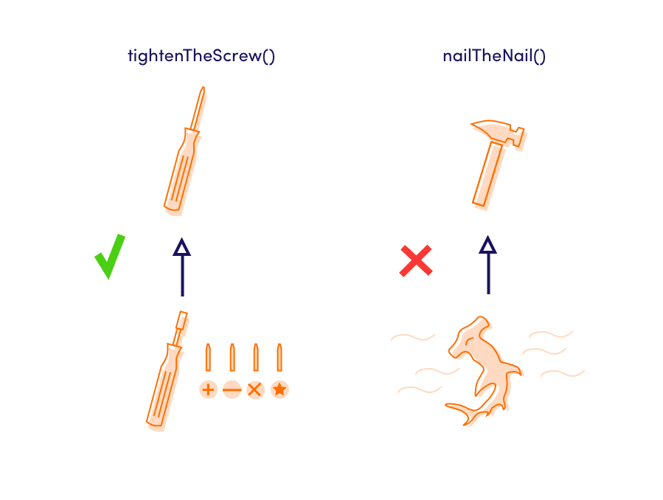
LSP Continued…
public abstract class WaterPipe
{
public abstract void CarryWater();
}
public class StandardPipe : WaterPipe
{
public override void CarryWater()
{
Console.WriteLine("Carrying water through standard pipe.");
}
}
public class HighPressurePipe : WaterPipe
{
public override void CarryWater()
{
Console.WriteLine("Carrying water through high pressure pipe.");
}
}
public class BrokenPipe
{
public void Repair()
{
Console.WriteLine("Repairing broken pipe.");
}
}
public class WaterDistributionSystem
{
public void DistributeWater(WaterPipe pipe)
{
pipe.CarryWater();
}
} WaterDistributionSystem system = new WaterDistributionSystem();
WaterPipe standardPipe = new StandardPipe();
WaterPipe highPressurePipe = new HighPressurePipe();
system.DistributeWater(standardPipe);
// Output: Carrying water through standard pipe.
system.DistributeWater(highPressurePipe);
// Output: Carrying water through high pressure pipe.

Slide 15
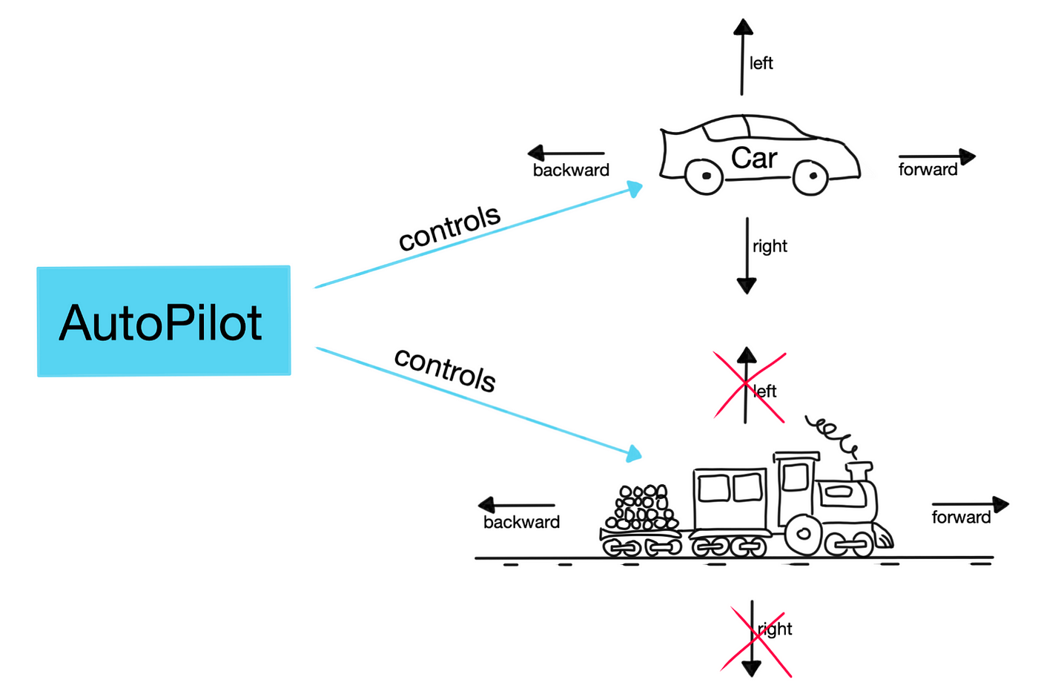
Interface Segregation Principle (ISP)
ISP states:
“Clients should not be forced to depend on interfaces they do not use.”
In other words, it’s better to have many small, specific interfaces rather than one large, general-purpose interface.
Class violating ISP public interface ICityWorker
{
void ControlTraffic();
void FightFire();
void RepairRoads();
}
Why ISP Matters?
Prevents classes from having to implement methods they don’t need.
Makes systems more modular and maintainable.
Reduces unnecessary dependencies and complexity.

Slide 16
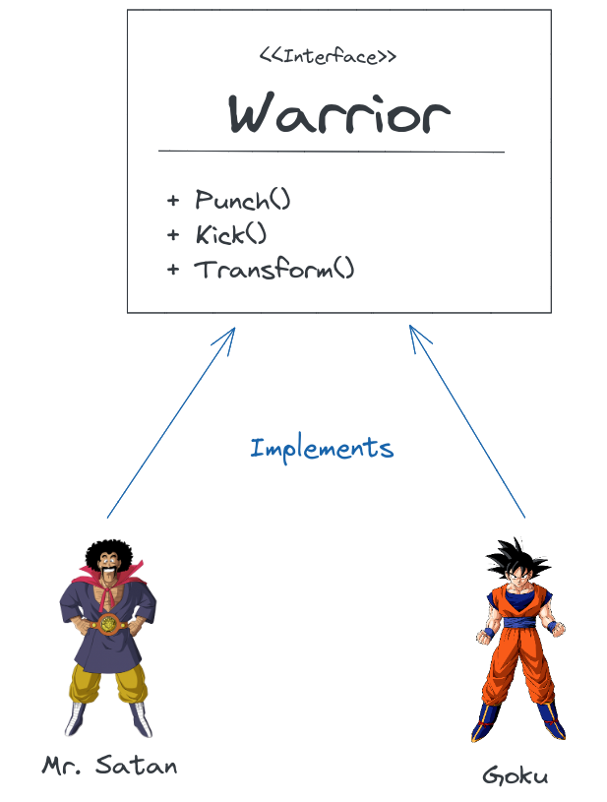
ISP Continued…
public interface ITrafficController
{
void ControlTraffic();
}
public interface IFirefighter
{
void FightFire();
}
public interface IMaintenanceWorker
{
void RepairRoads();
}
public class TrafficController : ITrafficController
{
public void ControlTraffic()
{
Console.WriteLine("Managing traffic signals.");
}
}
public class Firefighter : IFirefighter
{
public void FightFire()
{
Console.WriteLine("Extinguishing fire.");
}
}
public class MaintenanceWorker : IMaintenanceWorker
{
public void RepairRoads()
{
Console.WriteLine("Fixing roads.");
}
}

Slide 17
Dependency Inversion Principle (DIP)
DIP states:
“High-level modules should not depend on low-level modules. Both should depend on abstractions”
High-level classes (like business logic or service orchestration) shouldn’t directly instantiate or rely on specific concrete implementations.
Instead, both should rely on interfaces or abstract classes.
Use Dependency Injection (DI) to supply the implementation externally.
Class violating DIP public class CoalGenerator
{
public void GeneratePower()
{
Console.WriteLine("Generating coal power");
}
}
public class CityPowerManager
{
private CoalGenerator generator = new CoalGenerator();
public void SupplyPower()
{
generator.GeneratePower();
}
}
Why DIP Matters?
Enables flexibility — plug in new features without rewriting old logic.
Supports Open/Closed Principle — your code is open for extension via new implementations.
Reinforces Inversion of Control (IoC) — high-level logic no longer controls the concrete details.

Slide 18
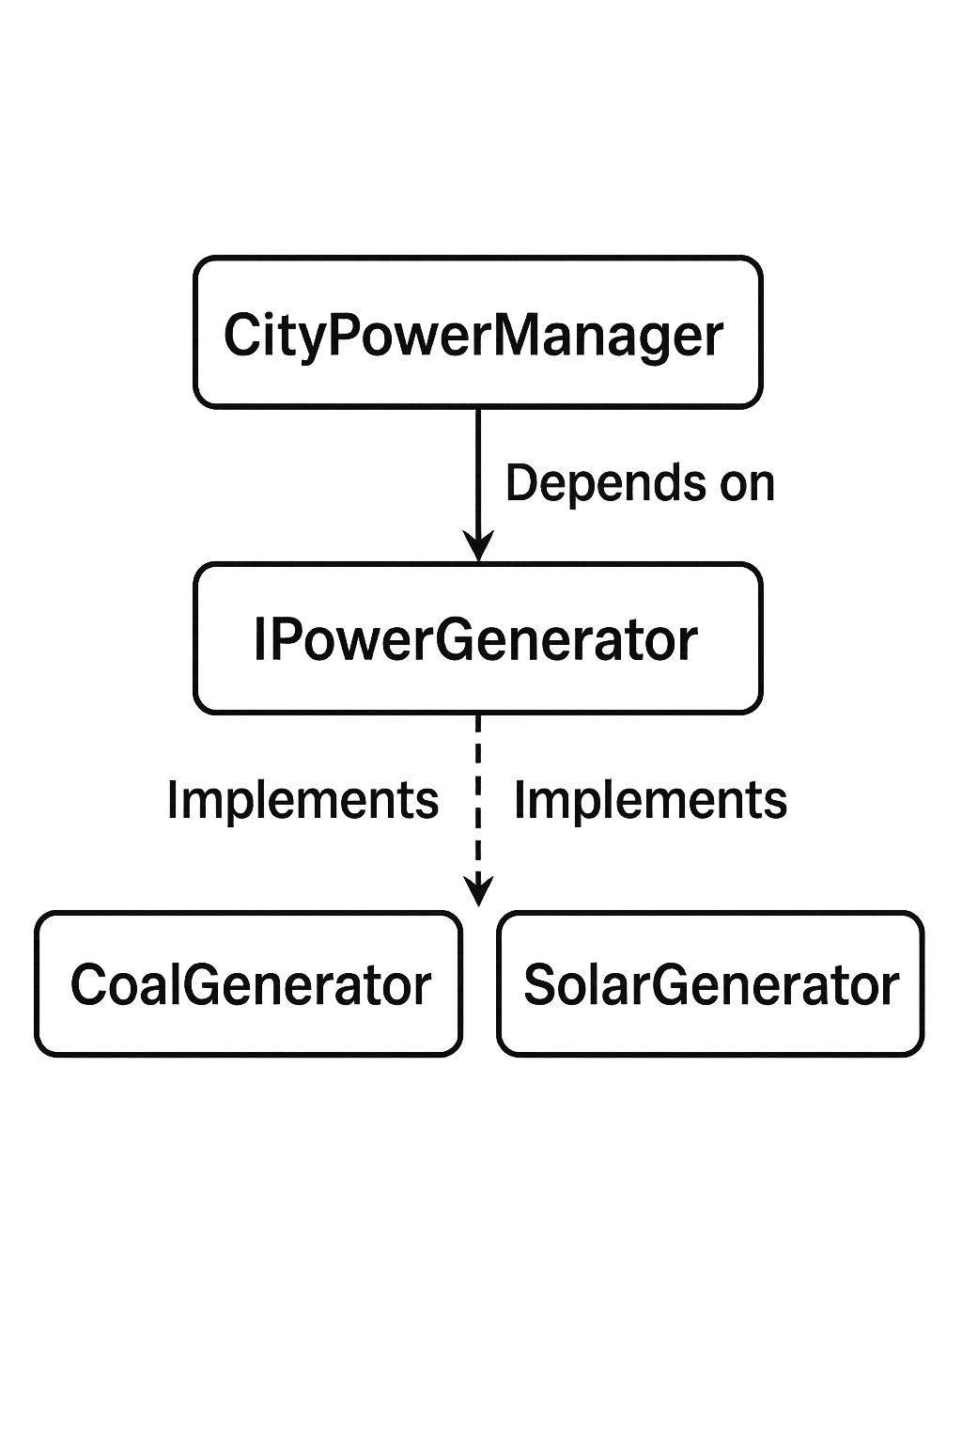
DIP Continued…
public interface IPowerGenerator
{
void GeneratePower();
}
public class CoalGenerator : IPowerGenerator
{
public void GeneratePower()
{
Console.WriteLine("Generating coal power");
}
}
public class SolarGenerator : IPowerGenerator
{
public void GeneratePower()
{
Console.WriteLine("Generating solar power");
}
}
public class CityPowerManager
{
private readonly IPowerGenerator _generator;
public CityPowerManager(IPowerGenerator generator)
{
_generator = generator;
}
public void SupplyPower()
{
_generator.GeneratePower();
}
} var manager = new CityPowerManager(new SolarGenerator());
manager.SupplyPower(); // Output: Generating solar power

Slide 19
Understanding LSP, ISP, and DIP Through Design Clarity
🧠 Why DIP ≠ LSP or ISP
Principle | Key Idea | Similarity | Key Difference
LSP | Subclasses must be usable wherever base classes are | Also involves abstractions | LSP is about behavior compatibility when replacing base with derived types
ISP | Don’t force classes to depend on things they don’t use | Also avoids “fat” dependencies | ISP is about splitting interfaces, DIP is about decoupling implementations
DIP | High-level code should depend on interfaces | Uses interfaces like ISP | DIP is about direction of dependency, not interface size

Slide 20
Summary
✅ SOLID Principles Summary — Building a Robust City Architecture
🔹 S – Single Responsibility Each class should do one thing only — like assigning one city worker to one job.
🔹 O – Open/Closed Your designs should allow new buildings (features) to be added without tearing down (modifying) the old blueprints.
🔹 L – Liskov’s Substitution New building types (subclasses) must behave like the ones they replace — no surprises in how they function.
🔹 I – Interface Segregation Don't make workers follow bloated job manuals — give them role-specific guides (small interfaces).
🔹 D – Dependency Inversion City systems (high-level modules) should rely on contracts, not concrete suppliers — making power sources and services easily swappable.
🏗️ Key Takeaway:
Design your code like you're building a city — scalable, modular, and prepared for change. SOLID = Sustainable, Organized, Logical, Independent, Decoupled

